Slide 1
Ethereum: How It Works?
Part 1

Slide 2
What is Ethereum?
Ethereum is a revolutionary global software platform driven by blockchain technology. Known for its native cryptocurrency, ether (ETH),
Ethereum is pivotal in the world of blockchain and decentralized finance. It is designed to be scalable, programmable, secure, and decentralized, allowing anyone to develop secure digital technologies.
Ether is utilized to power the blockchain and can also be used for payments across platforms that accept it.

Slide 3
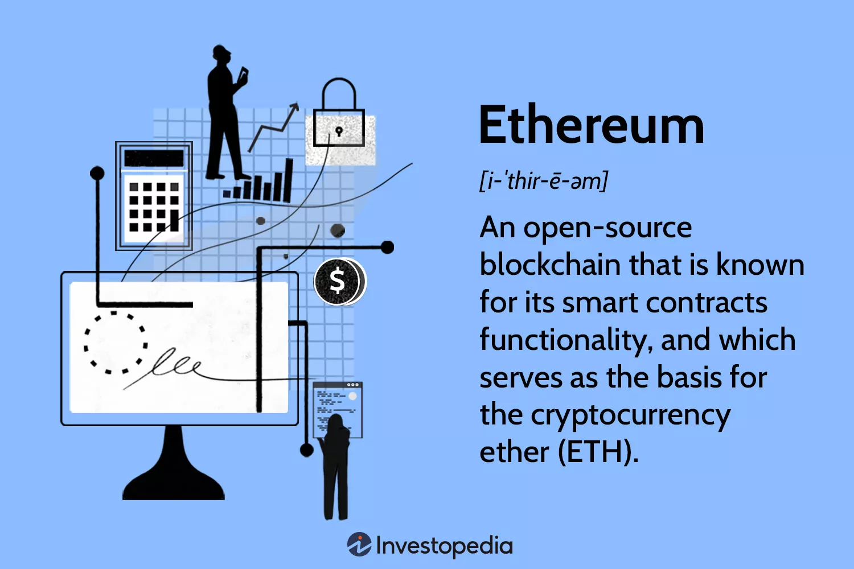
What is Ethereum

Slide 4
A Bit of History
Vitalik Buterin, credited with conceiving Ethereum, published a white paper introducing it in 2014.1 Ethereum was launched in 2015 by Buterin and Joe Lubin, the founder of ConsenSys, a blockchain software company.
The founders of Ethereum were among the first to consider the full potential of blockchain technology beyond just enabling a secure virtual payment method.
Since its launch, Ether has become the second-largest cryptocurrency by market value. It is outranked only by Bitcoin.
CoinMarketCap. "Today's Cryptocurrency Prices by Market Cap."

Slide 5
How it Works: Overview
Ethereum operates on a blockchain, a type of distributed ledger similar to a database.
Information is stored in blocks, each containing encoded data from the block before it (hash of previous block) and the new information.
This creates an encoded chain of information that cannot be changed. Throughout the blockchain network, an identical copy of the blockchain is distributed.
Each cell, or block, is created with new ether tokens awarded to the validator for the work required to validate the information in one block and propose a new one. The ether is assigned to the validator's address.
The network's automated programs validate a new block by reaching a consensus on its transaction information.
On the Ethereum blockchain, consensus is reached after the data and hash are passed between the consensus layer and the execution layer.
Enough validators must demonstrate that they all had the same comparative results, and the block becomes finalized.

Slide 6
Accounts
Two Types of Accounts:
External Accounts, which are controlled by private keys and have no code associated with them.
Contract Accounts, which are controlled by their contract code and have code associated with them.

Slide 7
External Accounts
An external account can send messages to other externally owned accounts OR to other contract accounts by creating and signing a transaction using its private key.
A message between two external accounts is usually a value transfer (like Bitcoin)
A message from an external account to a contract account activates the contract account’s code, allowing it to perform various actions

Slide 8
Contract Accounts
Contract accounts cannot initiate new transactions on their own.
They can only fire transactions in response to other transactions they receive from external accounts.

Slide 9
The Account State
He State of the Account Consists of Four Components
nonce: for external accounts, this number represents the number of transactions sent from the account’s address. For contract accounts, the nonce is the number of contracts created by the account.
balance: The number of Wei owned by this address.
storageRoot: A hash of the root node of a Merkle Tree that encodes the hash of the storage contents of this account (default: empty).
codeHash: The hash of the EVM (Ethereum Virtual Machine ) code of this account. For contract accounts, this is the code that gets hashed and stored as the codeHash. For external accounts, the codeHash field is the hash of the empty string.

Slide 10
Sate Tree
The state in Ethereum consists of a key-value map
The keys are addresses and the values are account declarations, listing the balance, nonce, code and storage for each account (AS we have seen, the storage is itself a tree).

Slide 11
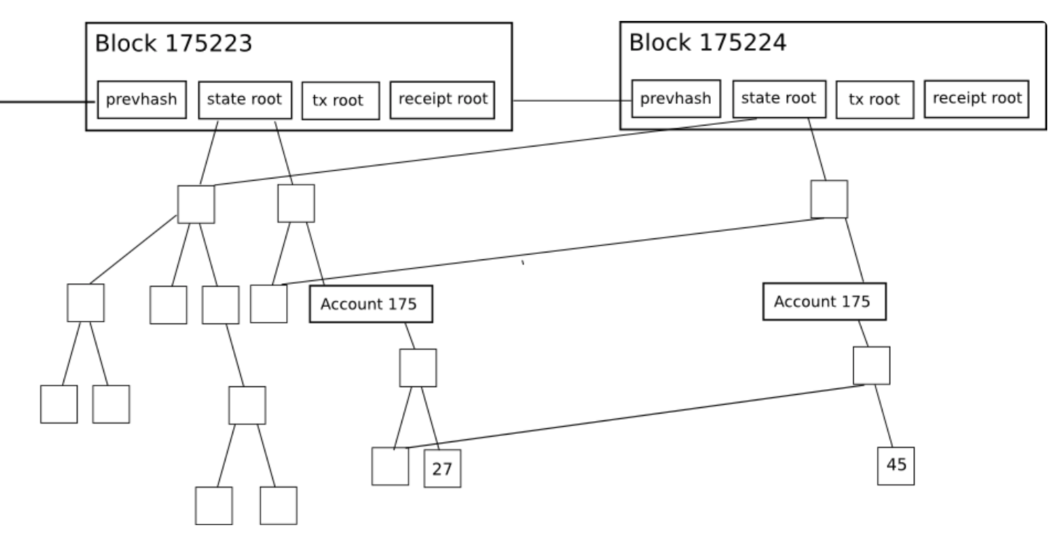
State Tree

Slide 12
Merkle Trees
a way of hashing a large number of “chunks” of data together which relies on splitting the chunks into buckets,
Each bucket contains only a few chunks,
then taking the hash of each bucket and repeating the same process,
continuing to do so until the total number of hashes remaining becomes only one: the root hash.

Slide 13
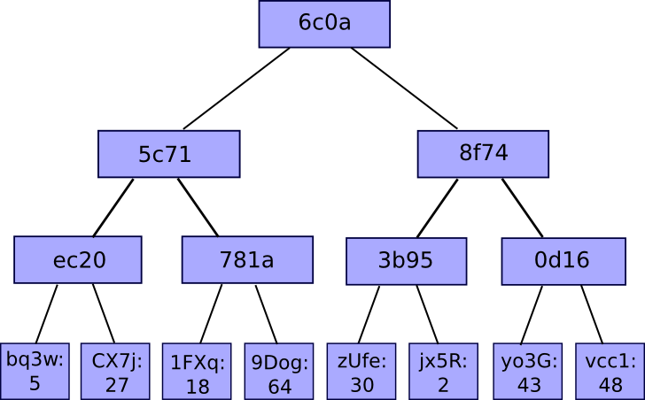
Merkle Trees

Slide 14
Merkle Trees
a Binary Merkle Tree is a data structure in which each node has at most two children.
This implies that we combine two inputs together to obtain a single output

Slide 15
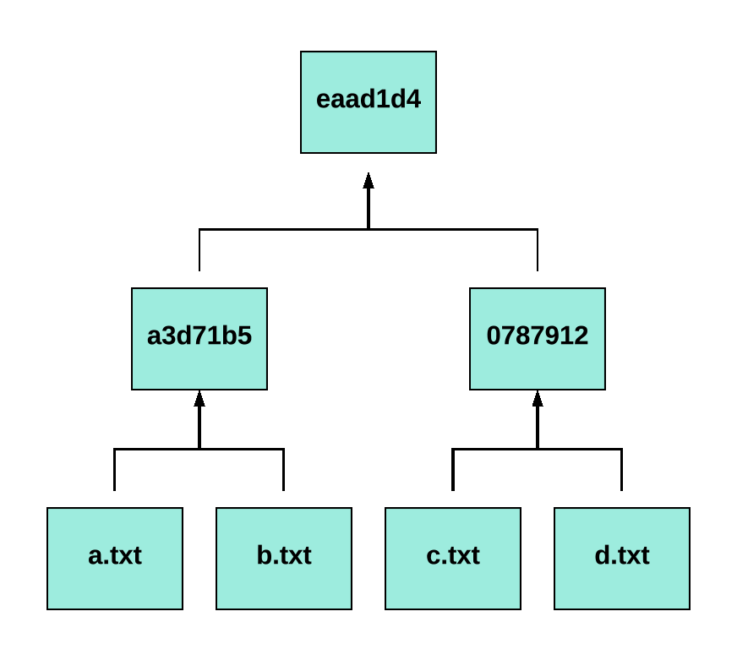
Example

Slide 16
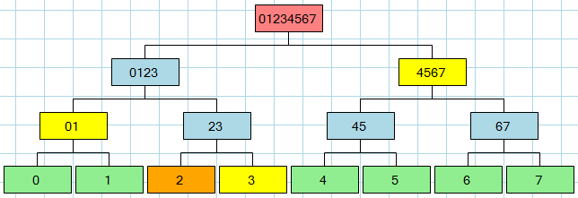
Validation: Prove that “2” is included

Slide 17
Inside the Ethereum Node
An Ethereum node includes an Ethereum client and a blockchain database.
The client contains a client process, an Ethereum Virtual Machine, a memory pool, and a JSON-RPC API exposing the functionality of the node externally.
There are two types of nodes: full nodes and mining nodes.

Slide 18
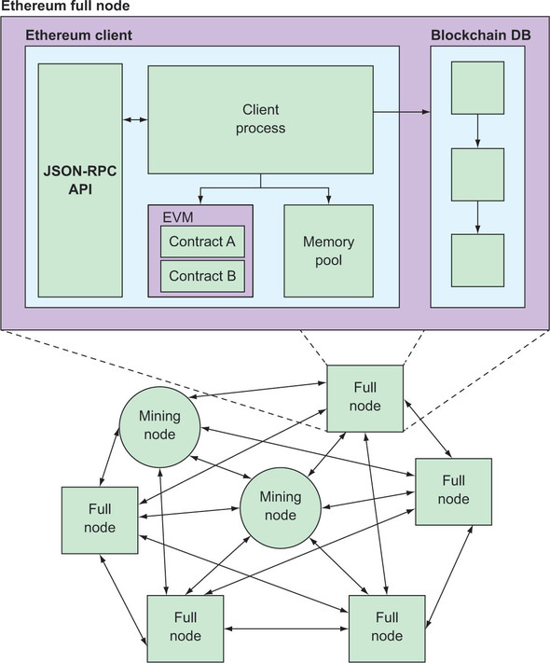
The Full Node

Slide 19
Components of the Full Node
An Ethereum client—This acts as a runtime and contains four elements:
A virtual machine called Ethereum Virtual Machine (EVM), capable of executing smart contract code generally written in a language called Solidity and compiled into EVM bytecode.
A memory pool, where the node stores transactions that it receives, such as a vote submitted by a voter from the client side, before it propagates them further into the network.
A client process, which coordinates the processing. It handles incoming messages and transactions, dispatches them to the EVM when appropriate, and stores transactions to, and retrieves them from, the memory pool. The client process also handles incoming blockchain blocks that the node receives from peer nodes and appends them to the local copy of the blockchain database.
A JSON-RPC API, which exposes the functionality of the client to other nodes and external users.

Slide 20
Components of the Full Node
A blockchain database—Apart from transaction data, such as votes submitted by voters, the blockchain also keeps a copy of the EVM bytecode of all smart contracts deployed on the network and holds their state. Mining nodes append new blocks to the blockchain regularly, every 15 seconds.

Slide 21
The Journey of a Transaction (see the Diagram in the next slide)
Assume that there is a voting DApp through which voters can cast their votes
To cast a vote, the voter invokes the voting functions in the voting smart contract
This generates a voting transaction through the JSON-RPC interface
The node places the transaction in the memory pool and executes it on the EVM for validation.
If the validation is successful, the transaction is broadcast to peer nodes until it reaches a mining node; otherwise, it dies out.

Slide 22
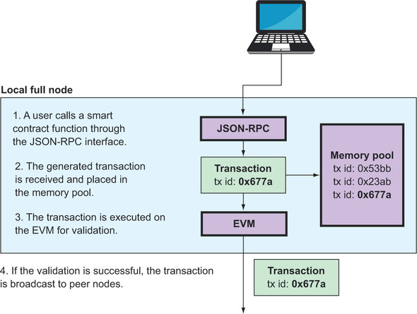
The Journey of a Transaction

Slide 23
The Journey of a Transaction: The Mining Phase (see the Diagram in the next slide)
6. A mining node receives the transaction from a peer node and places it in its memory pool.
7. The node later picks it and executes it on the EVM, among other transactions, to place it on a new block.
8. If the block is appended on the blockchain, the transaction is removed from the memory pool and the block is broadcast to peer nodes.

Slide 24
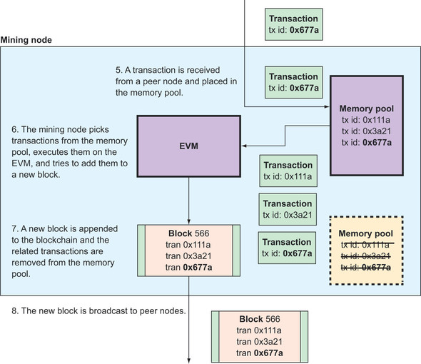
The Journey of a Transaction: The Mining Phase

Slide 25
The Journey of a Transaction: When a full node receives a new block
9. When a full node receives the new block it processes all transactions included on the EVM for validation
10. if validation is successful, it removes the related transactions from the memory pool and propagates the block further into the network

Slide 26
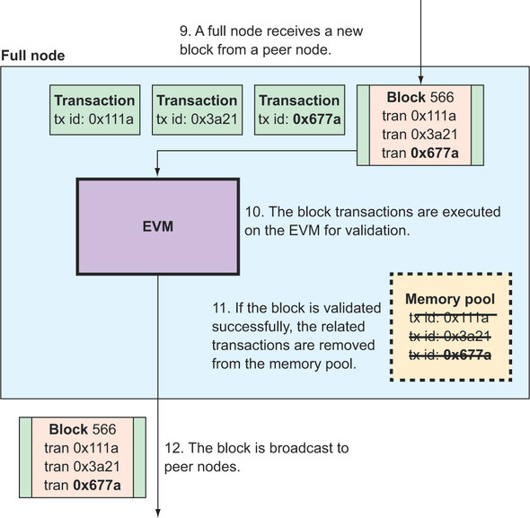
The Journey of a Transaction: When a full node receives a new block

Slide 27
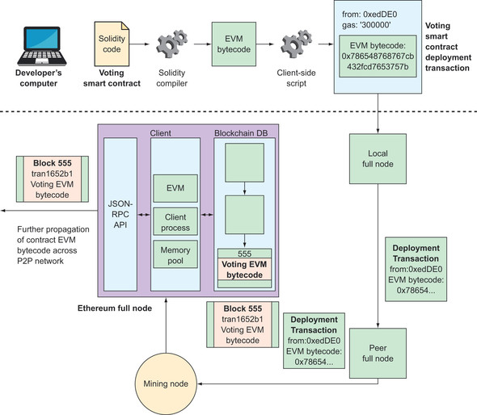
The Development View

Slide 28
Ethereum Consensus Algorithms: The Proof of Work Version: Ethash
Ethash is the Ethereum PoW algorithm. It uses an evolution of the Dagger–Hashimoto algorithm, which is a combination of Vitalik Buterin’s Dagger algorithm and Thaddeus Dryja’s Hashimoto algorithm.
Ethash is dependent on the generation and analysis of a large dataset, known as a directed acyclic graph (or, more simply, “the DAG”).
The DAG had an initial size of about 1 GB and will continue to slowly and linearly grow in size, being updated once every epoch (30,000 blocks, or roughly 125 hours).

Slide 29
Ethash
The purpose of the DAG is to make the Ethash PoW algorithm dependent on maintaining a large, frequently accessed data structure.
This in turn is intended to make Ethash “ASIC resistant,” which means that it is more difficult to make application-specific integrated circuits (ASIC) mining equipment that is orders of magnitude faster than a fast graphics processing unit (GPU).
Ethereum’s founders wanted to avoid centralization in PoW mining, where those with access to specialized silicon fabrication factories and big budgets could dominate the mining infrastructure and undermine the security of the consensus algorithm.

Slide 30
Ethash
The algorithm works is as follows:
There exists a seed which can be computed for each block by scanning through the block headers up until that point.
From the seed, one can compute a 16 MB pseudorandom cache. Light clients store the cache.
From the cache, we can generate a 1 GB dataset, with the property that each item in the dataset depends on only a small number of items from the cache. Full clients and miners store the dataset. The dataset grows linearly with time.
Mining involves grabbing random slices of the dataset and hashing them together. Verification can be done with low memory by using the cache to regenerate the specific pieces of the dataset that you need, so you only need to store the cache.
The large dataset is updated once every 30000 blocks, so the vast majority of a miner's effort will be reading the dataset, not making changes to it

Slide 31
The Challenge in Ethash
Similar to Bitcoin, the core idea behind mining is to find a nonce (a random arbitrary number), which, once concatenated with the block header and hashed, results in a number that is lower than the current network difficulty level. Initially, the difficulty was low when Ethereum was new, and even CPU and single GPU mining was profitable to a certain extent, but that is no longer the case. Now, only either pooled mining or large GPU mining farms are used for profitable mining purposes.
Ethash is a memory-hard algorithm, which makes it difficult to be implemented on specialized hardware. As in Bitcoin, ASICs have been developed, which have resulted in mining centralization over the years, but memory-hard PoW algorithms are one way of thwarting this threat, and Ethereum implements Ethash to discourage ASIC development for mining.
Ethash is a memory-hard algorithm and developing ASICs with large and fast memories is not feasible. This algorithm requires subsets of a fixed resource called Directed Acyclic Graph (DAG) to be chosen, depending on the nonce and block headers.

Slide 32
Ethereum now switched off Proof-of Work (Dec 2022) – Moved to proof of Stake
Ethash was Ethereum's proof-of-work mining algorithm. Proof-of-work has now been **switched off entirely** and Ethereum is now secured using proof-of-stake instead. Read more on The Merge, proof-of-stake and staking. This page is for historical interest!

